Slide 1
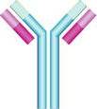
Immunology Biol 465 Minot State University Spring 2020
MWF 9-9:50 am
Lab Tuesdays 9am-noon

Slide 2
Lecture 32 For April 27th , 2020
Announcement-
Quiz 5 ---Grading now. I’m sorry not done.
Lab 7—par1—linked now. Lab tomorrow. ELISA assay.
BB meeting 9 am. https://us.bbcollab.com/guest/7f526f619a424a1691e0f86bc1bca654

Slide 3
Reminder…2 weeks from today.
Final exam---Monday May 11th Final exam 8-9:50 am.
Quiz 6 will be incorporated into the final exam. The final exam will be partially new material and partially cumulative.
The majority of points for the final exam will come from one question related to an immune response from beginning to end.

Slide 4
Final exam Monday May 11th 8:00-10:00 am.
You will be guided with regard to the cumulative content to prepare for.
Will likely be one question related to an immune response from beginning to end.

Slide 5
Where were we?
We had wrapped up T-cell activation and effector mechanisms.
Ended with some info on T_{reg} cells. They are essential for a controlled immune response, but limit the host response to cancer cells.
Immune checkpoint inhibitors are proving effective in keeping T-cells on the job of killing cancer cells!

Slide 6
T_{reg} cells
What is their role? How do they work?

Slide 7
They can keep APCs from being good at activating T-cells…

Slide 8
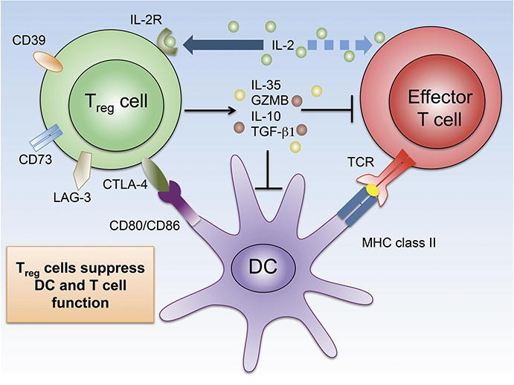
T_{regs} secrete cytokines (IL-10 and TGF-β) that also prevent differentiation of certain types of T-cells.
Figure 9.34 and

Slide 9
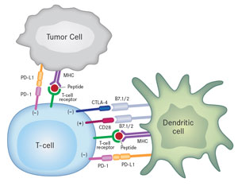
One important discovery we have learned about a while back, is that cancer cells evolve features of T_{regs} that allow them to shut down the activity of T-cells with specificity for tumor antigens.

Slide 10
(See figure in chapter 9)
CTLA-4 binds to B7 costimulatory molecules with ~20X higher affinity than CD28.
When CTLA-4 binds B7 an inhibitory signal is sent to the T-cell-–to NOT respond to the antigen being presented.

Slide 11
Tumor’s are especially good at modulating the expression of these inhibitory signals to T-cells.
Scientists have learned that the T-cell response to cancer antigens is severely limited by molecules like CTLA-4 and PD1ligand
Some of the most successful therapies for some types of cancer focus on this T-cell down regulation.

Slide 12
Checkpoint blockade therapies
Ipilimubab---monoclonal anti-CTL-4 antibody.
Nivolumab---monoclonal anti PD1 antibody
Durvolumab—monoclonal anti PD1L antibody
*other similar drugs exist…

Slide 13
Moving on!
Humoral immune response—Chapter 10:
Activation of B-cells
Secretion of antibodies—Ultimately something in the blood (one of the humors of the body) elicits an effect upon a pathogen.

Slide 14
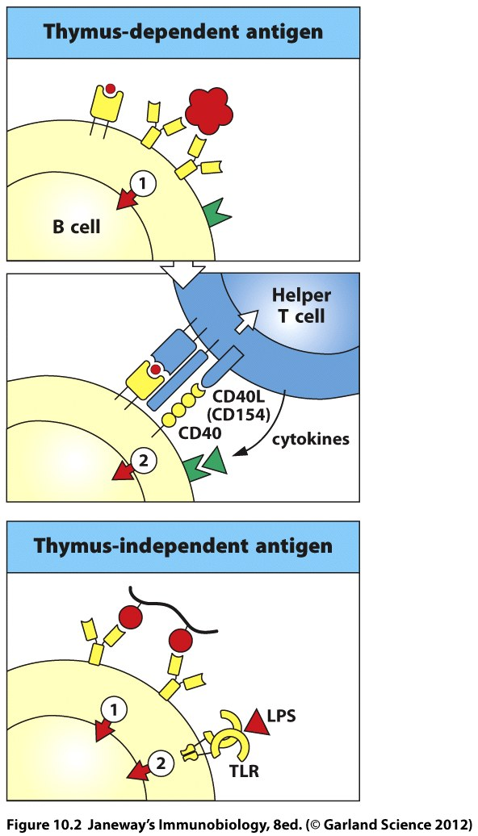
Multiple signals!
Signal 1 sent through binding of free antigen
Signal 2 sent through binding of peptide from antigen to T-cell TCR and CD4
AND
Simultaneous binding of CD40 to CD40 ligand.

Slide 15
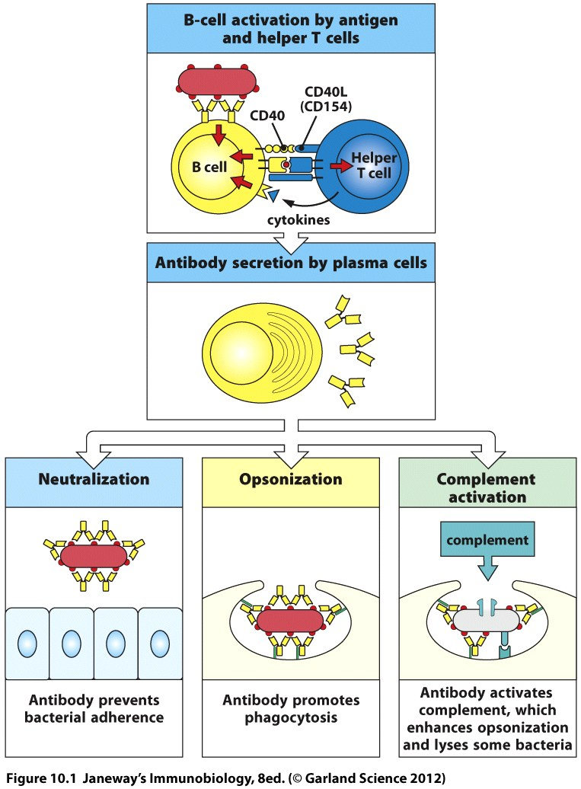

Slide 16
When B-cells, which have previously bound free antigen are activated by TH cell, we know that both the B- and the T-cell have recognized the same pathogen.
In other words the random joining of gene segments which formed one cell’s BCR and the other cell’s TCR, happened to create antigen receptors which match the same pathogen. Cool!

Slide 17
This is known as linked recognition.
Now we call the T-cell that helps the B-cell, the B-cell’s cognate T-cell, since it recognized the same antigen.

Slide 18
So…in linked recognition, the B-cell and the T-cell must recognize something from the same pathogen, but it is usually a different component of the pathogen.
In other words, the epitope of the BCR and the TCR are usually different.

Slide 19
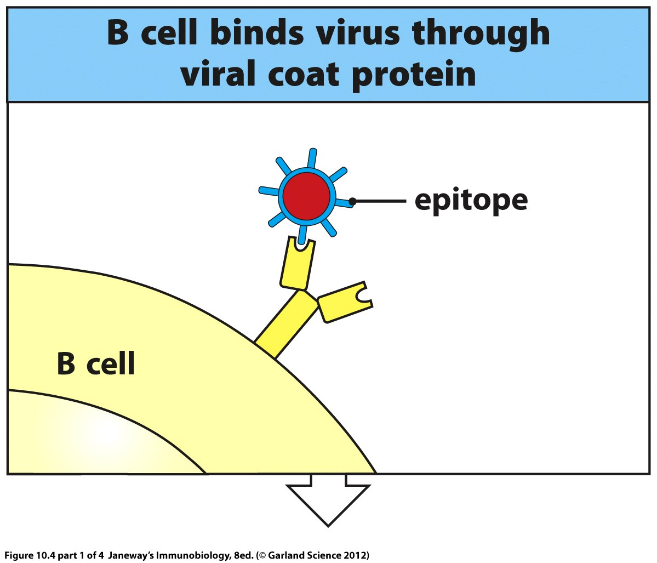

Slide 20
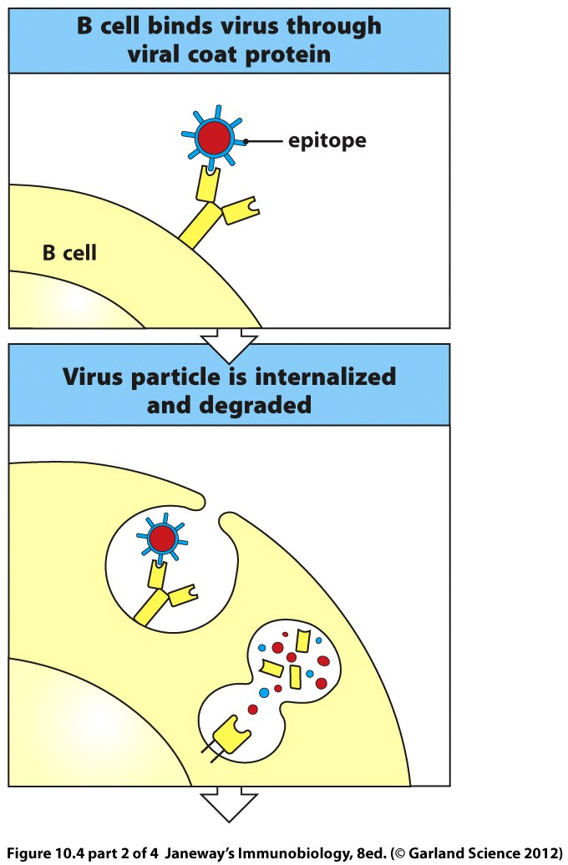

Slide 21
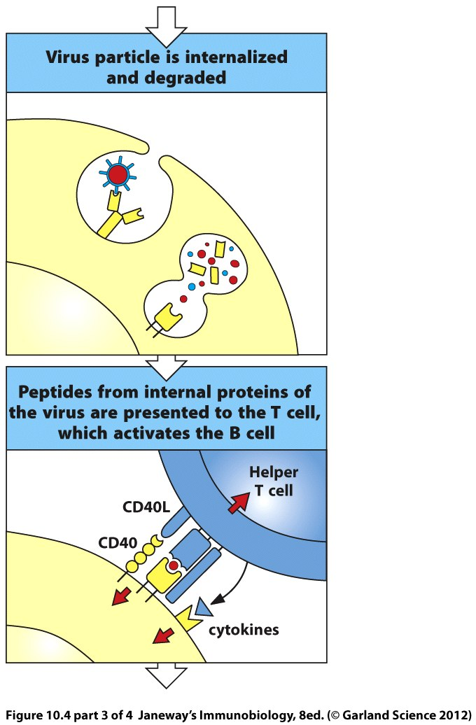

Slide 22
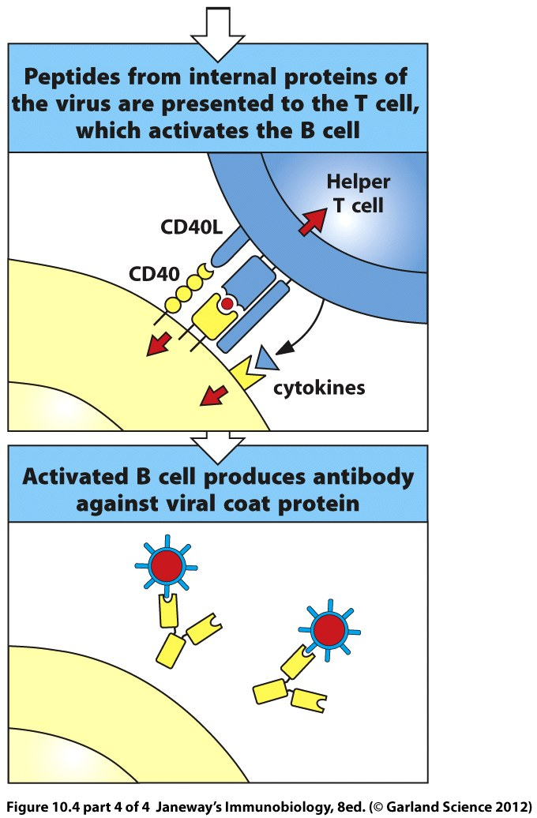

Slide 23
Be sure to review the application of this…the linking of a protein antigen to an unrelated antigen in a vaccine.
“adjuvant” technology.

Slide 24
Applying scientific discovery…
We’ve been able to tweak the system of TH cell activation of B-cells in vaccination design.
To elicit a strong B-cell response against a pathogen, the antigen of interest may be linked to a protein (not normally part of the pathogen).

Slide 25
The protein component might be part of a pathogen that the person was previously vaccinated against, or something known to elicit a strong T-cell response.
In the end, the new composite antigen tricks the person’s T-cells into helping B-cells that have recognized the non-protein antigen.

Slide 27
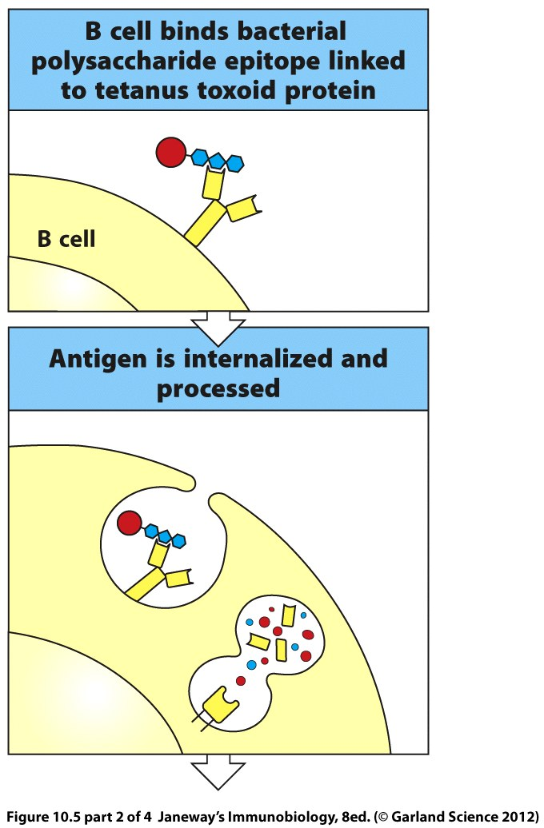

Slide 28
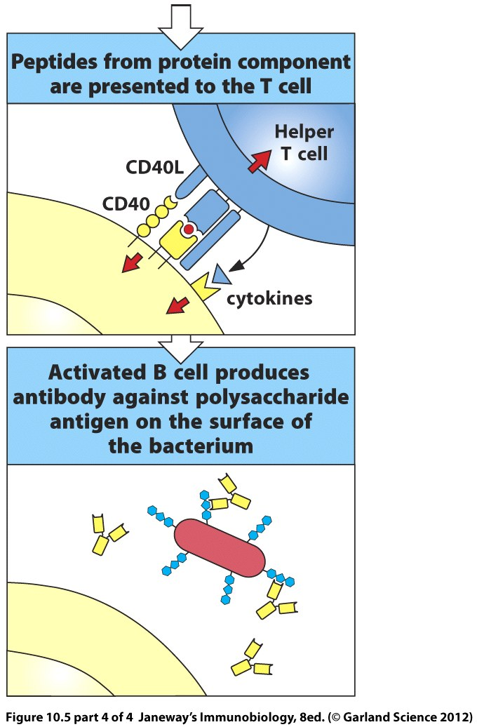

Slide 29
Where is all of this helping/activation taking place?
In a peripheral lymphoid organ. We can finally understand the organization of the lymph node!

Slide 30
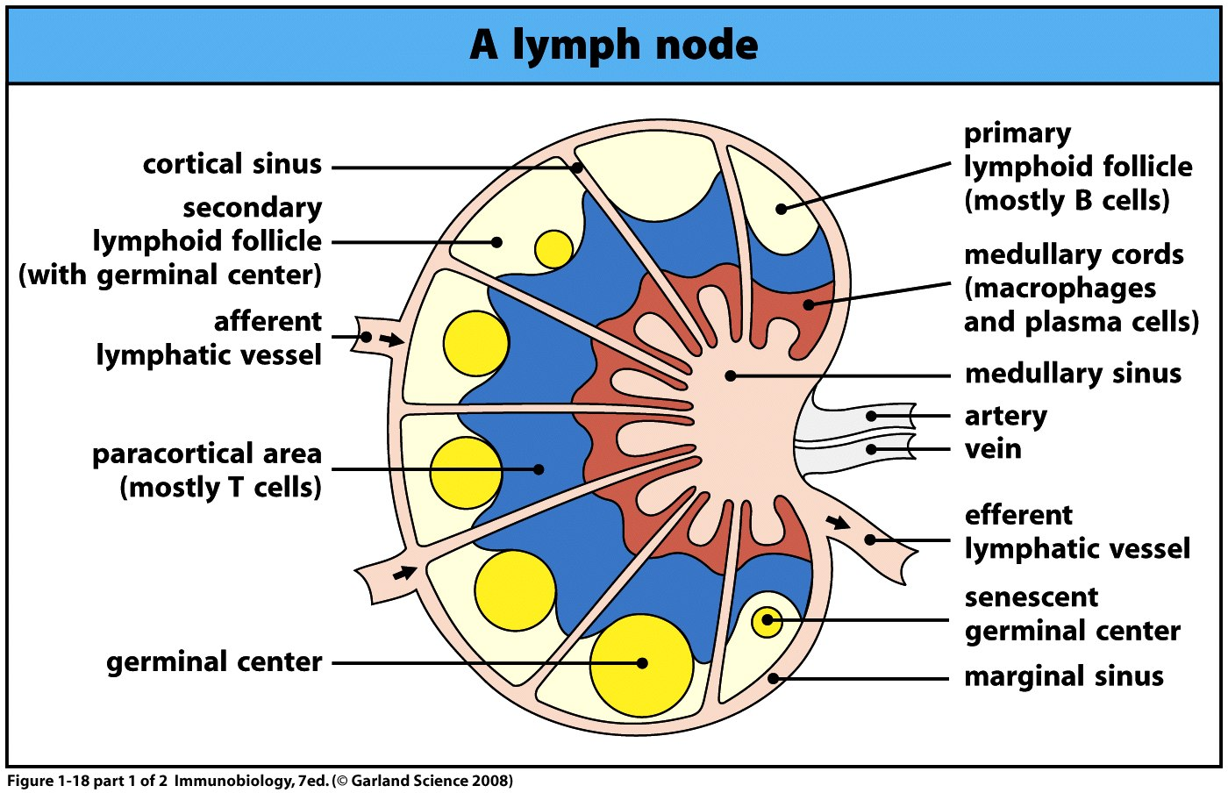
B and T-cells are located in adjacent compartments

Slide 31
Within the B-cell-containing follicles, B-cells that have bound their cognate antigen, migrate to the border between the two areas.
Likewise, activated T-cells migrate toward the B-cell areas.
They encounter each other at the border.

Slide 32
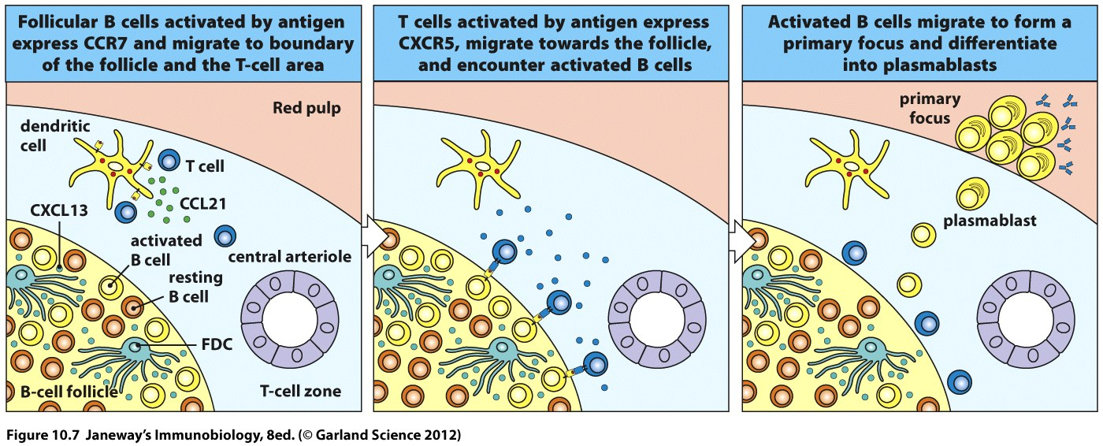

Slide 33
The restricted regions for B and T-cells increases the likelihood that a B-cell and its cognate T-cell will meet up.
Once activated the B-cell forms a primary focus (the collection of expanding clones)
The B-cells are called plasmablasts at this point. (young plasma cells)

Slide 34
It only takes about 5 days after encountering foreign antigen, for a primary focus to appear in lymph nodes.

Slide 35
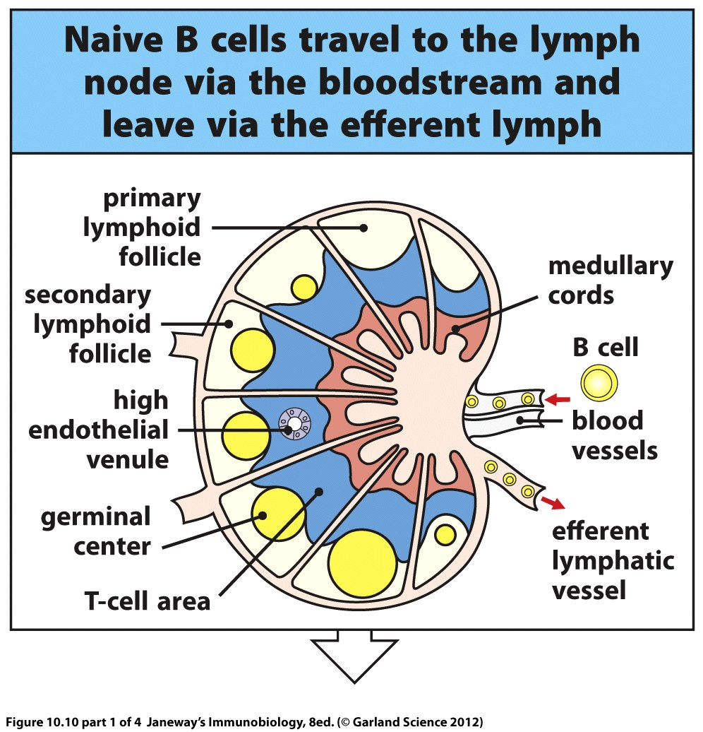

Slide 36
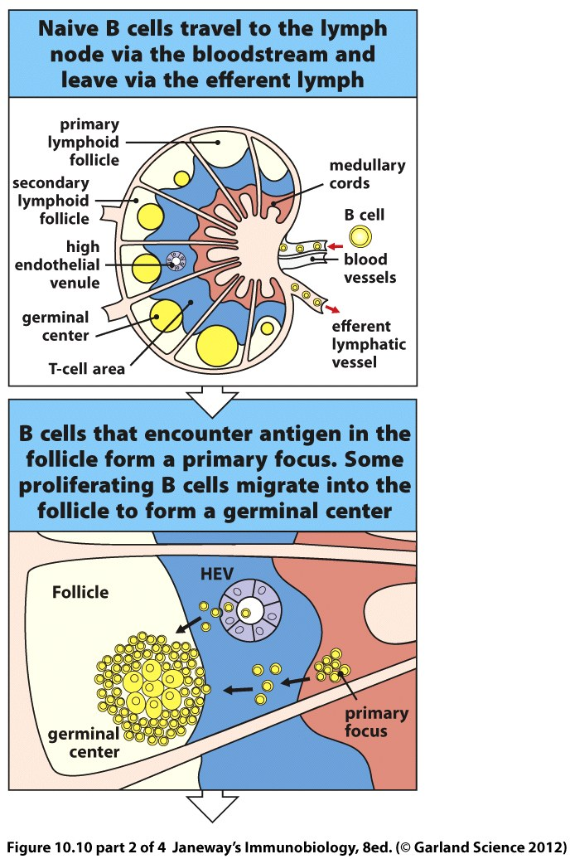

Slide 37
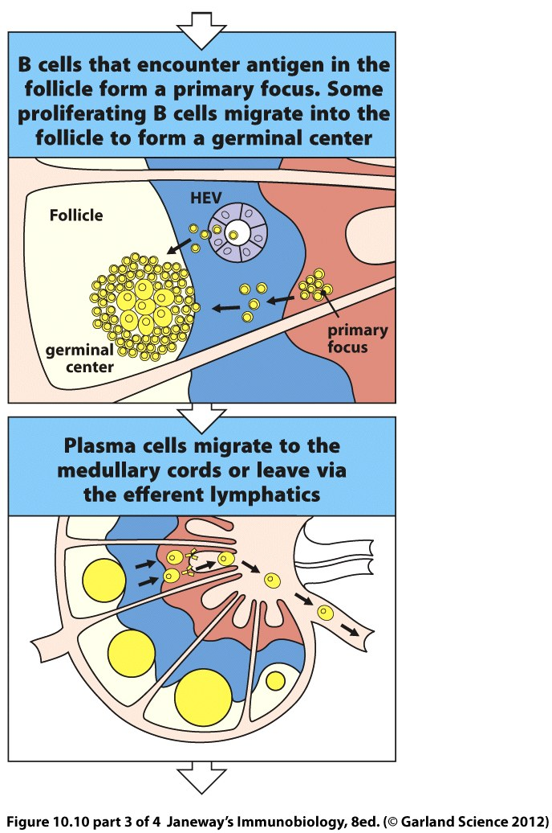

Slide 38
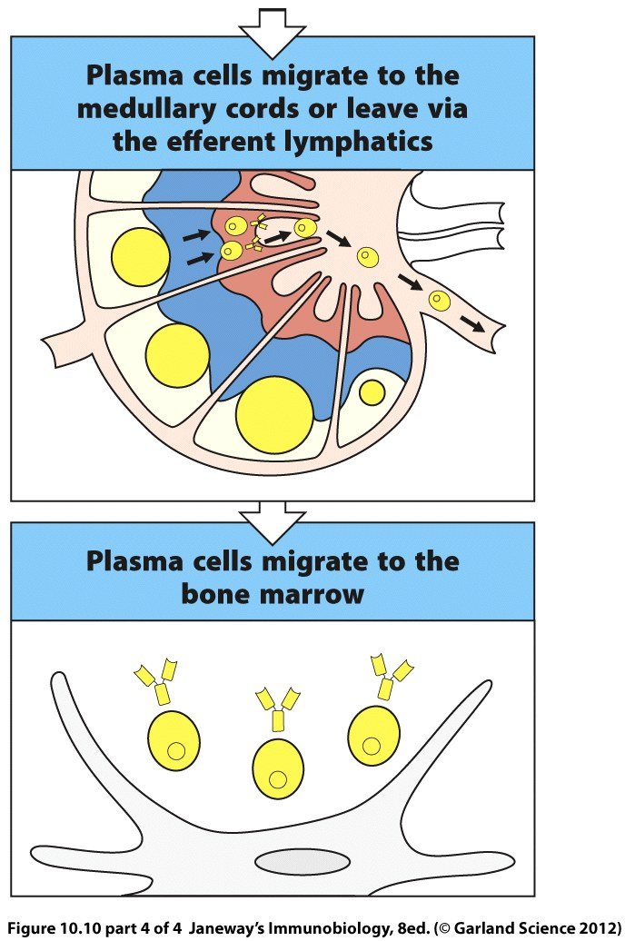

Slide 39
Remember how hard B-cells work to become part of our lymphocyte repertoire?
They continue to try to improve after activation…recall secondary diversification?
A B-cell in the germinal center will undergo those random mutations in the V-region gene segments.

Slide 40
Somatic Hypermutation

Slide 41
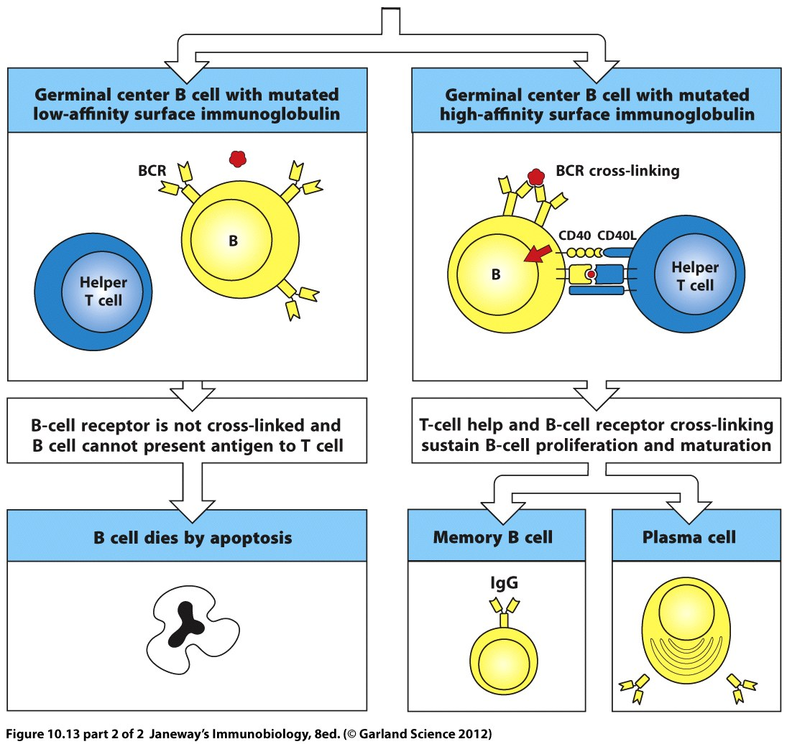

Slide 42
This process is also known as affinity maturation and insures that only the best B-cells persist in a B-cell humoral response.

Slide 43
B-cells will also undergo isotype class switch which allows production of antibodies with different effector functions.
As discussed following questions last time, isotype switch is driven by signal transduction (not a random event like V-D-J segment rearrangement)

Slide 44
A major player in signaling isotype switch is the CD40 ligand on the TH cell.
In addition, specific cytokines trigger specific switches,
(Isotype switch absolutely requires helper T-cells)

Slide 45
